Slide 1
UNIT I11 INTRODUCTION TO MARKETS AND PRICING STRATEGIES

Slide 2
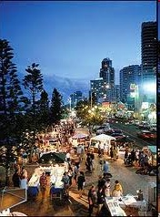
What is a Market?
Market is defined as a place or point at which buyers and sellers negotiate their exchange of well-defined products or services.

Slide 3
Market
Market is any area over which buyers and sellers are in close touch with one another, either directly or through dealers, that the price obtainable in one part of the market affects the prices paid in other parts. - Benham

Slide 4
MARKET CLASSIFICATION
Classification on the basis of Area covered or location
Classification on the basis of time &
Classification on the basis of degree of competition

Slide 5
Classification on the basis of Area covered or location
Local market
National market
International market

Slide 6
Classification on the basis of time
very short period market
Short period market
Long period market

Slide 7
Classification on the basis of degree of competition
Perfect market
Imperfect market
Imperfect market take several forms
Monopoly
Duopoly
Oligopoly
Monopolistic competition

Slide 8
Types of competition
Competition is of two types
Perfect competition
Imperfect competition

Slide 9
PERFECT COMPETITION
A market structure in which all firms in an industry are price takers and in which there is freedom of entry into and exit from the industry is called Perfect Competition.
The market with perfect competition condition is known as perfect market.

Slide 10
FEATURES OF PERFECT MARKET
Large number of buyers and sellers
Price taker
Homogeneous products
The firms are free to enter or leave the industry
Perfect Mobility of factors of production
Perfect knowledge
No publicity cost
Uniform prices
AR curve is parallel to X axis

Slide 11
IMPERFECT COMPETITION
A market structure in which all the firms in the industry are price makers and in which there lies restrictions to enter in to the industry is called Imperfect Competition.
The market with imperfect competition condition is known as imperfect market

Slide 12
FEATURES OF IMPERFECT MARKET
Sellers and buyers
Nature of commodity
No uniform prices (price discrimination)
Entry is restricted
No perfect knowledge
Price maker
Publicity cost
AR curve is downward sloping [MR curve is always below AR curve]

Slide 13
Features of MONOPOLY
Single seller & large number of buyers
No close substitutes
Entry restricted
Price discrimination
AR curve is downward slowing from left to right
In monopoly firm & industry are one and same. i.e., single firm represents the whole industry.

Slide 14
Features of MONOPOLISTIC competition
In this market many firms produce differentiated products. (e.g. Anacin, Disprin, Saridon)
Goods produced are close substitutes to each other
No restriction to enter in to the market

Slide 15
Price & out put determination in MONOPOLY
Monopoly is form of imperfect market.
No uniform prices (price discrimination)
AR curve is downward sloping [MR curve is always below AR curve]

Slide 16
Cost & out put relationship
Units of Output Q | Total fixed cost TFC | Total variable cost TVC | Total cost (TFC + TVC =) TC | Average variable cost (TVC / Q) AVC | Average fixed cost (TFC / Q) AFC | Average cost (TC/Q) AC | Marginal cost MC
0 | 60 | - | 60 | - | - | - | -
1 | 60 | 20 | 80 | 20 | 60 | 80 | 20
2 | 60 | 36 | 96 | 18 | 30 | 48 | 16
3 | 60 | 48 | 108 | 16 | 20 | 36 | 12
4 | 60 | 64 | 124 | 16 | 15 | 31 | 16
5 | 60 | 90 | 150 | 18 | 12 | 30 | 26
6 | 60 | 132 | 192 | 22 | 10 | 32 | 42

Slide 17
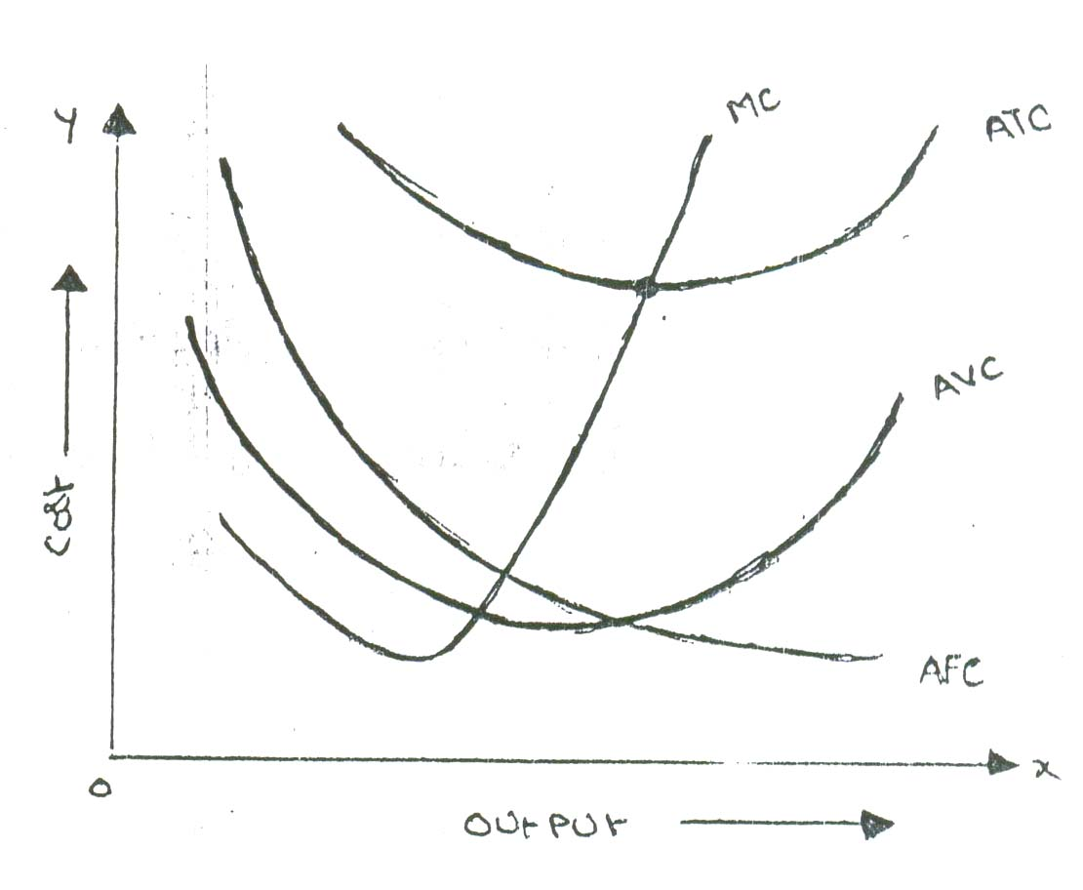

Slide 18
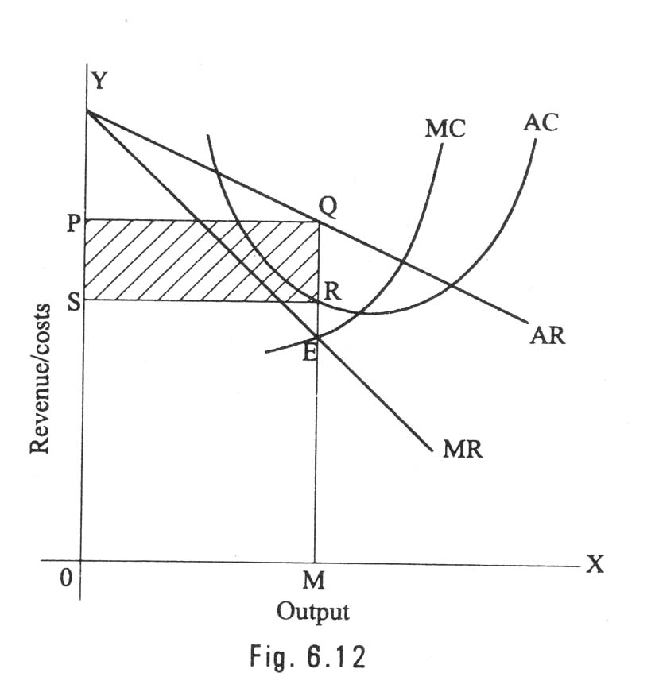
PRICE OUTPUT DETERMINATION UNDER MONOPOLY

Slide 19
PRICING
Pricing is not an exact science, more often, are done by trial & error.
Pricing is an important exercise, Under pricing will result in losses and over pricing will make the customers run away.
To determine price in a scientific manner it is necessary to understand pricing methods & procedures.

Slide 20
PRICING OBJECTIVES
Maximize profits
Increase sales
Increase market share
Satisfy customers
Meet the competition

Slide 21
PRICING METHODS
Cost Based Pricing Methods
Cost plus pricing (full cost or mark up)
Marginal cost pricing (break even or target profit pricing)
Competition Oriented Pricing
Sealed bid pricing
Going rate pricing
Demand Oriented Pricing
Price Discrimination (differential pricing)
Perceived value pricing

Slide 22
PRICING METHODS
Strategy Based Pricing Methods
Market Skimming
Market Penetration
Two part pricing
Block pricing
Commodity Bundling
Peak load pricing
Cross Subsidization
Transfer pricing (internal pricing technique)
Limit pricing

Slide 23


